Slide 1

Smart Automation Controller
for Precision Agriculture
Design Discussion
Notes:
In this presentation we will be discussing the an automation controller and how precision agriculture can improve the state of plant health

Slide 2
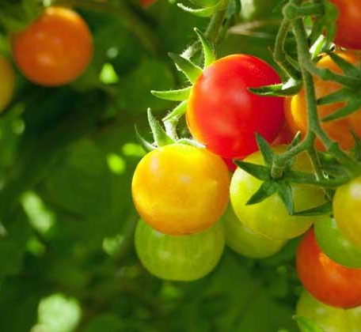
Motivation
Excessive use of pesticides
Precision agriculture
Healthier planet
Notes:
In order to avoid the excessive pesticide use that is seen in modern day agriculture, we researched techniques that confirms the intuitive idea that precision agriculture should reduce overall environmental damage, yield more healthier crops and preserve neighboring ecosystems.
Finding solutions to agricultural problems directly improves the health of the plant, the health of our planet and reflects onto our physical and mental aptitudes.

Slide 3

Outline
Off the grid
Limited access
Power efficient
Resource constrained
FPGA accelerated
Convolutional Neural Network
Two main implementations
Notes:
This project focuses on off the grid agricultural farms, where the need to detect plant diseases through plant medical centers is limited.
Therefore this project aims to create a power efficient, resource constrained FPGA accelerated edge device that can classify different plant diseases by using a convolutional neural network model.
Ultimately, this project delivers two main implementations; an application implementation based on vectorized convolutions and an mnist vhdl implementation based on spatial convolutions.

Slide 4
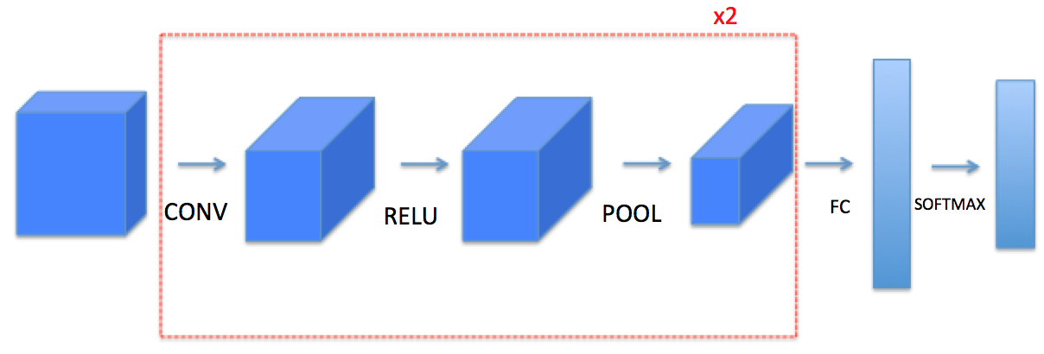
CNN Architecture
Figure 1 - CNN Structure
Notes:
Convolutional neural network architectures are similar in theory across all implementations, a top level review into CNN architectures describes a 3 tier model of input, output and hidden layers.
As shown, the hidden layer enclosed in red, typically consists of connected blocks that filter through the input in order to allow for feature extraction and then classification.
The operations executed inside the hidden layer are executed in a loop, multiple times over.
In practice, the operations of the hidden layer are set together and labeled as a Convolutional Block.

Slide 5

Convolution Layer
Figure 2 - Convolution Operation (Green: Input, Yellow: Kernel, Red: Output)
Notes:
One of the main pillars of CNN architecture is the convolution operation.
Following is the spatial 2D convolution, which is executed by performing dot products.
By multiplying input and kernel values element-wise, followed by a summation then adding the bias, if present.

Slide 6
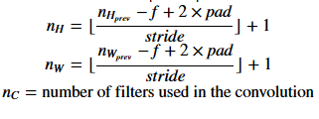
Convolution Output Size
(#images) x (n_H) x (n_W) x (n_C)
Figure 3 - Preprocessing of Convolution Output Dimensions
Notes:
In order to execute research that is practical, we outline the following equations that are used to dynamically calculate the output size of the 2D convolution operation.

Slide 7
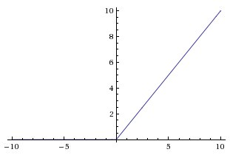
ReLU Layer
Figure 4 - ReLU function Graph
Notes:
The output of convolution is then forwarded as inputs to the following block. Which is the Rectified Linear Unit (ReLU).
ReLU introduces nonlinearity in order to create complex signals
These complex signals are then used to describe complex functions.
These functions are able to then classify and cluster together features that describe the different classes.

Slide 8
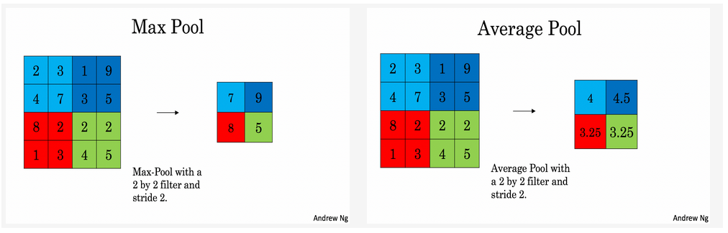
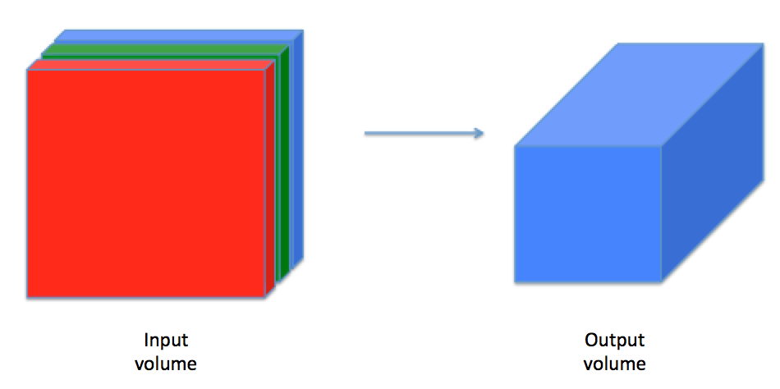
Pooling Layer
Figure 5 - Convolution Output Depth [14]
Figure 6 - Pooling Types
Notes:
An unwanted outcome of the convolution operation is that the result carries increased tensor dimensionality as shown in figure 5.
Fortunately, the pooling layer can counteract such problems via its use of nonlinear down sampling.
Pooling slides a window of size f x f with a specified stride value. This allows the kernels to store the same feature maps but in downsampled form as can be seen in figure 6.

Slide 9
Platforms
NVIDIA GeForce 6800 Ultra (GPU) has a 3.3X speedup compared to the Intel 3GHz P4 (CPU) [5].
FPGA often speeds up the performance by 3-4X compared to GPU [6].
Notes:
Besides CPUs and GPUs, FPGA-based accelerators have become a researching topic for deep neural network applications which is a possible solution to exceed GPUs in performance and power usage.
After testing neural networks including 200 hidden layers on MNIST data sets. Gpu performance was found to be better than cpu . the test results show NVIDIA GeForce 6800 ultra has 3.3x speedup compared to the intel 3FHz P4 while FPGA often speeds up the performance by 3-4X compared to GPU.

Slide 10
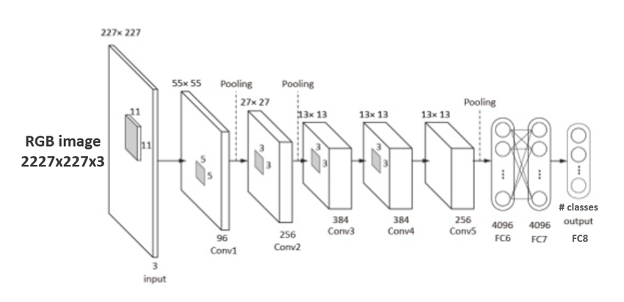
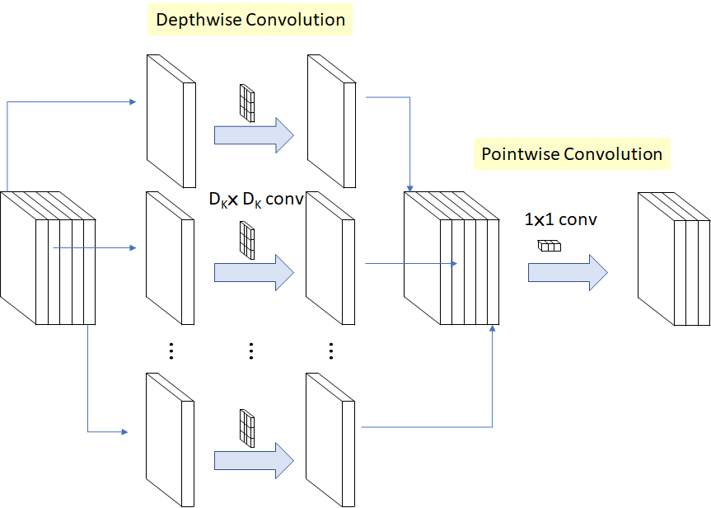
Model Architectures
Notes:
In order to approach the implementation in a lightweight manner, every part of the project aims to achieve a balance between efficiency and accuracy.
Thus the MobileNet architecture is researched in order to outline its advantages and drawbacks as compared to standard architectures.
MobileNet model uses Depthwise Separable convolutions, these types of separable convolutions achieve the same results that the standard convolution uses by models such as Alexnet, but in a subdivided form.
This is achieved by splitting the standard convolutional operation into 2 parts; the depthwise convolution and the pointwise convolution.

Slide 11
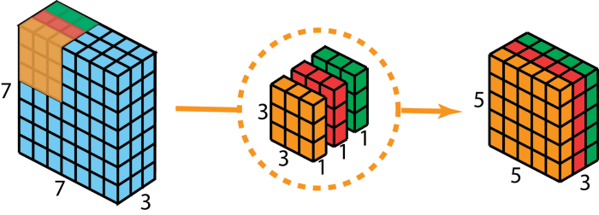
Depthwise Convolution
Figure 7 - Depthwise Convolution
Notes:
As shown in figure 7, the depthwise convolution applies the multiplication accumulation operation of convolution on singular kernels to each image depth.

Slide 12
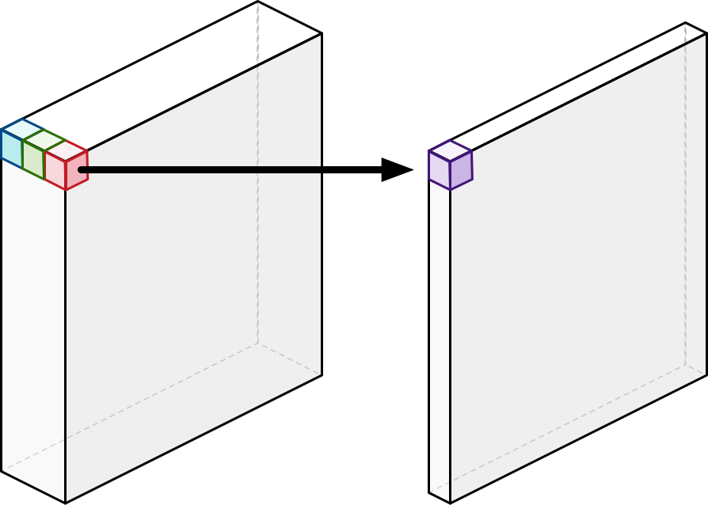
Pointwise Convolution
Figure 8 - Pointwise Convolution
Notes:
Followed by having the outputs of the depthwise convolution then combined using a 1x1 convolution by the pointwise convolution.
Pointwise convolution is used to further reduce input depth.

Slide 13
MobileNet Hyperparameters
Notes:
In order to accommodate platforms like FPGAs that leverage faster computation and lower power efficiency over limited resources, engineers have access to MobileNet’s hyperparameters which aim to reduce model input and parameter sizes.
Shown is the depthwise separable computational complexity, appended on to it is α (width multiplayer) and ρ (resolution multiplier).
These variables can fundamentally reduce computational cost and resolution of parameters.
Both are used in our own Mobilenet implementations.

Slide 14
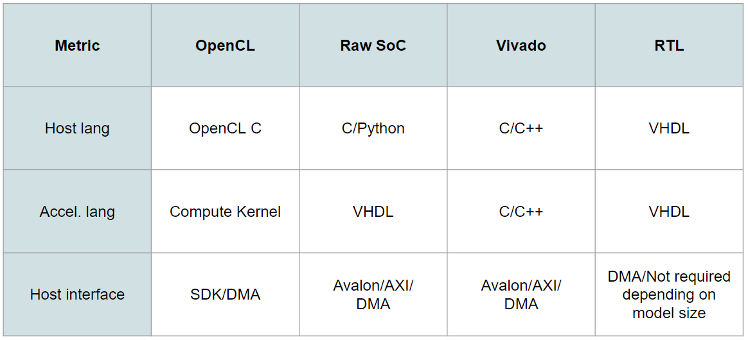
CNN on FPGA
Vivado
OpenCL
Raw Implementation
RTL
Notes:
Out of 33 papers that were collected for an implementation review, it was noted that approximately 75% of the reviewed implementations opted for using high level synthesis (HLS) tools in order to quickly iterate upon their implementations and avoid low level designs.
Tools like OpenCL and Vivado follow a more guided approach for design by using C-like languages which can fully synthesize the accelerated function into multipliers, counters, and so on.
However, this approach leverages scalability and short design times with utilization inefficiency, less design control and lower throughput compared to RTL approaches.
Following is a general attribute table for the researched CNN implementations on FPGA. This allows us to focus our efforts on specific tools rather than a wide approach.

Slide 15
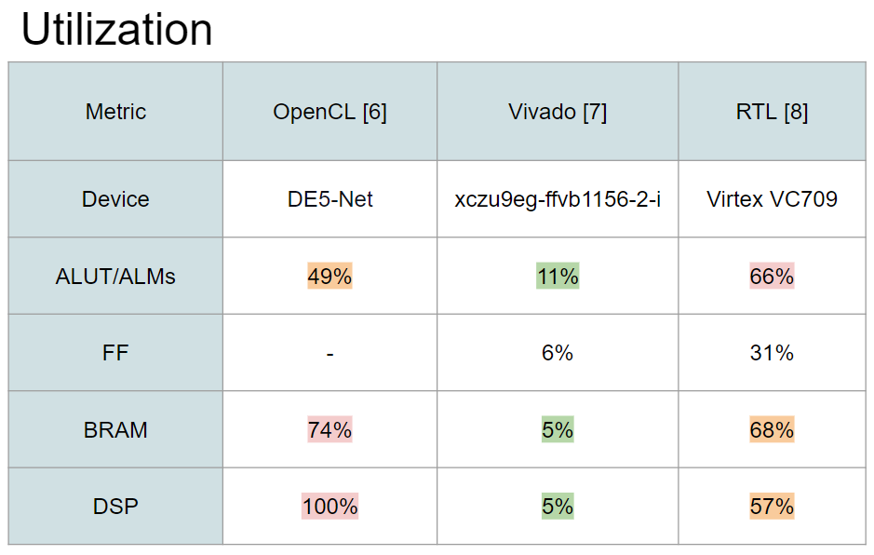
Utilization
Notes:
Following are 3 papers reviewed in order to gain a more practical outlook on where to proceed with our design.
It can be inferred that the OpenCL implementation subjects it's device to maximum utilization in terms of BRAM and DSP chips as compared to the Vivado and RTL approach.

Slide 16
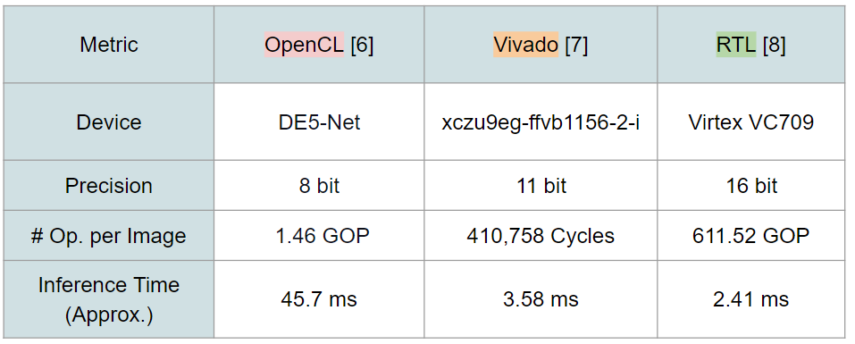
Performance
Notes:
In terms of execution performance, the OpenCL fares the lowest in terms of precision used and the inference time.
It is important to note that the Vivado implementation successfully implements the input layer and one convolutional layer.
By extrapolation; it can be deduced that the RTL will yield more efficiency and extract higher throughput than both HLS approaches by a large margin.

Slide 17
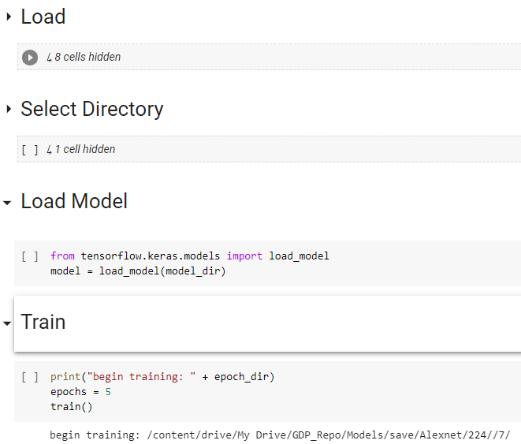
Applicational Implementation
Alexnet
224x224
128x128
MobileNet
224x224(1 & 0.25)
128x128(1 & 0.25)
Notes:
In order to clearly document our implementation, we chose to list the items in the order we applied it during the implementation phase. Firstly beginning with our methodology into training a model that meets the application requirements.
To allow for a modular approach, a custom model training, validation and evaluation suite was implemented on Google cloud servers to allow for parallel, quick and reliable model creation.
36 models were trained with the use of TensorFlow/Keras libraries to reach an accuracy of 98~99% inside the Google cloud suite. However, this report aims to place focus on six models for discussion and analysis.
Through creative problem solving, we were able to utilize this cloud environment despite it having a 12 hour session timeout and the models requiring multiple days to train.

Slide 18
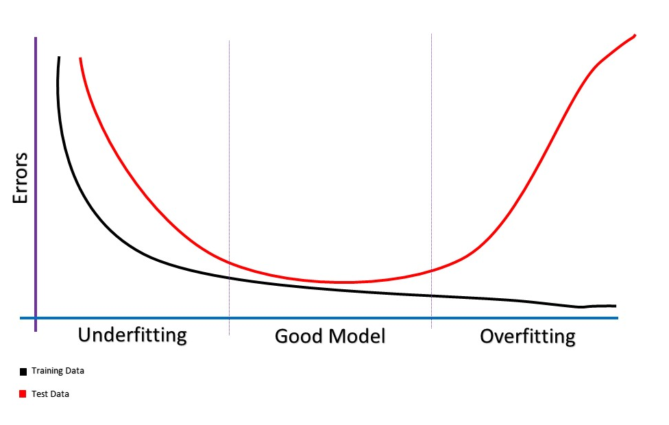
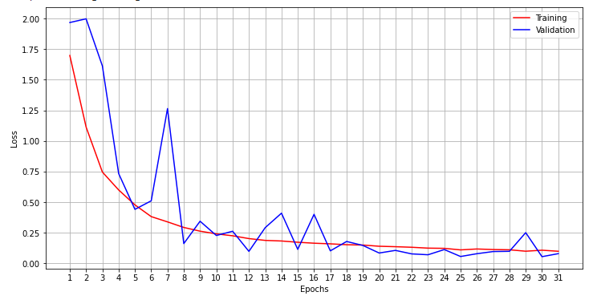
Fitness
Figure 9 - Epoch/Loss Graph
Figure 10 - Model Fitness Reference Graph
Notes:
According to the theory of model fitness approximation, argues for an empirical approach of per model basis for selecting the most appropriate epoch that approximates the whole model fitness.
For the model presented in figure 9, epoch number 23 was selected as it provided most appropriate evaluation metrics for accuracy and a balanced fitting empirical metric for an averagely fit model according to the reference graph shown in figure 10.

Slide 19
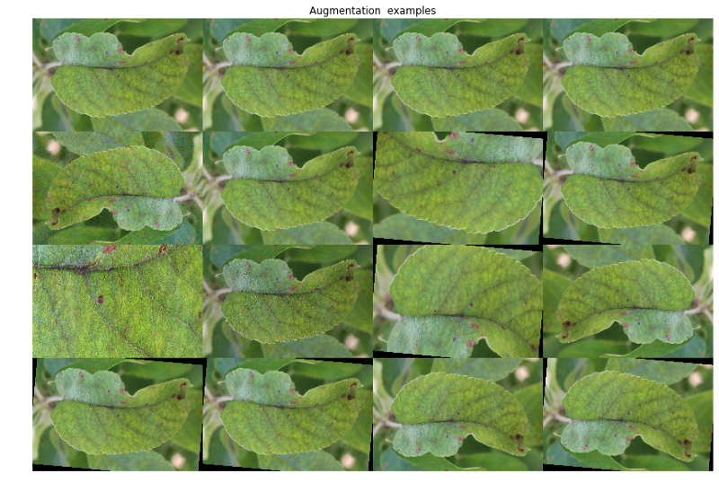
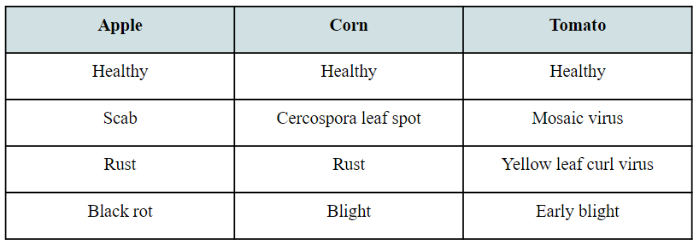
Dataset
PlantVillage: 22,700 images
Accuracy Paradox
Image Augmentation
Model classes
Notes:
The dataset used is from PlantVillage, where our models were trained on 22,700 images, which were approximately equally split between the 12 classes to avoid accuracy paradox.
A model that is suffering from accuracy paradox would create a function that describes that it is most probable for inputs to belong to the classes that contain more training images, rather than relying on the features extracted.
The training images had image augments introduced to them by random shearing, zooming, rotation, dimensional shifts and horizontal flips. Which was forced to randomise at every 12 hour session.
This allowed for large variance in terms of accommodating for different input image conditions.
Following are the 12 classes that our models can classify and infer.

Slide 20
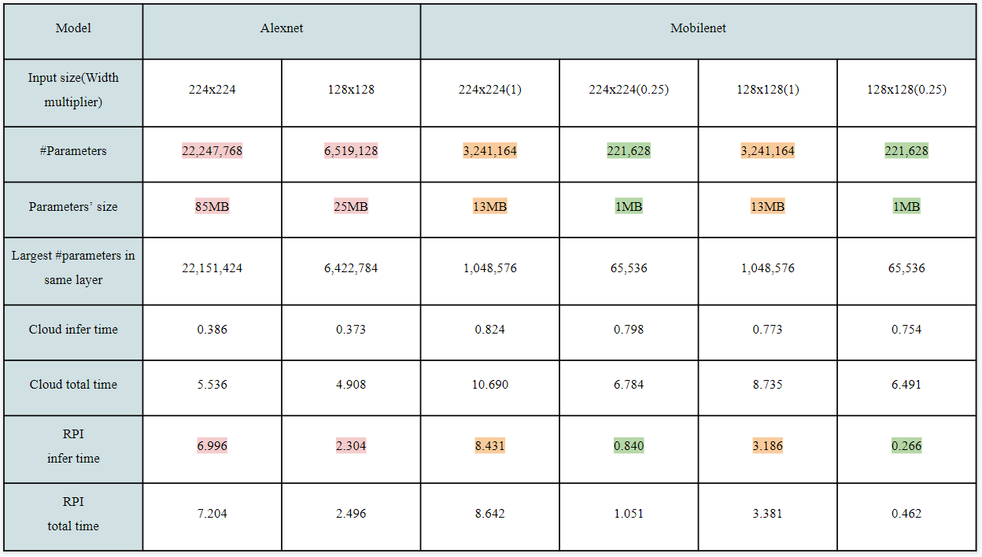
Metrics
Notes:
Aggregated metrics of the chosen 6 models are presented and discussed to provide contrast between them. The platforms are both Google cloud servers and Raspberry Pi Zero with the models executed via Tensorflow lite. Moreover, the evaluation was done on the same input image across all models.
Time metrics are calculated based on an average of 3 runs. The total time is the time of inferring plus the time to load the parameters, model and input image.
It can be deduced that Alexnet models have considerably larger parameter size than Mobilenet models with little accuracy loss.
The 1MB models open doors for further weight pruning and fixed point quantization which can further reduce the parameter size. Moreover, this smaller size will allow for on-fabric implementations which will introduce objectively fast and more efficient implementations.

Slide 21
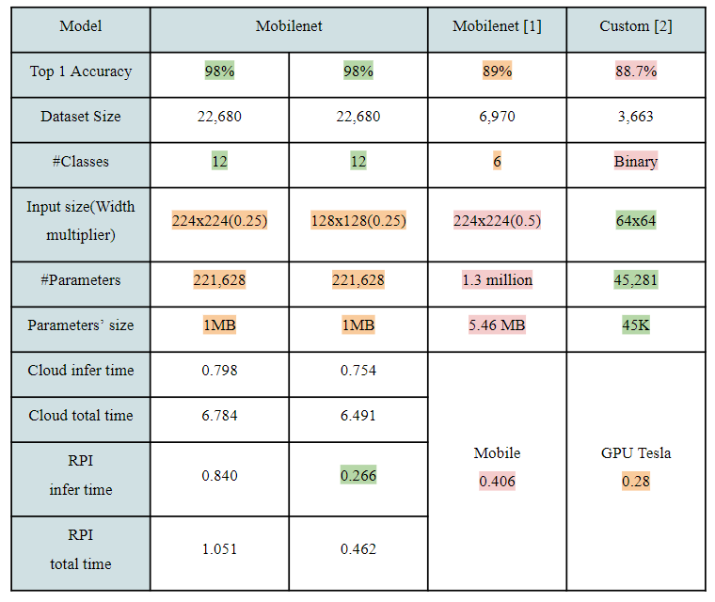
Comparison
Notes:
Comparing our implementation to other attempts to tackle similar applications provides feasibility.
It can be concluded that compared to the current edge, our memory and storage footprint models find balance between accuracy and efficiency.

Slide 22
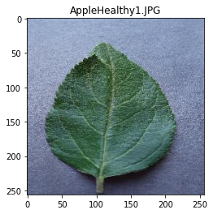
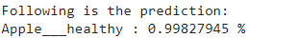
Custom CNN Implementation
Figure 12 - Output of the Model
Figure 11 - Input to the Model
Notes:
By using the TensorFlow high level libraries, our trained MobileNet model can be given image inputs of the 12 classes of plant images and would output a correct classification with high accuracy.
An example of an input of a healthy apple plant is shown in figure 11.
TensorFlow exposes a function inside its model class called predict, this function when given the input image as argument, would apply the forward pass of the parent model class and output a prediction as shown in figure 12.

Slide 23
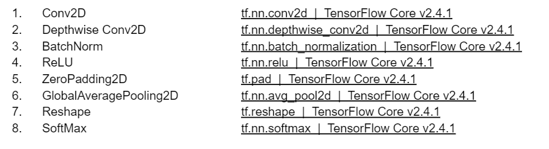
Building Blocks Reconstruction
Figure 13 - Building Block Documentation
Notes:
TensorFlow is elegant and useful in many applications, however it abstracts alot of its functionalities for the sake of simplicity.
However, in the case of our design, it was essential to carry out the complex computations on the FPGA for acceleration, however the robust approach of TensorFlow proved indivisible.
Thus, an approach that aims to understand the optimized implementations of the TensorFlow functions and reconstruct them without the use of any of the TensorFlow libraries was undertaken.
In order to begin tackling such a problem, we first devised a list of the building blocks that are used to create the MobileNet V1 architecture, shown in the below figure are the building blocks and their counterpart TensorFlow implementations’ documentation.

Slide 24
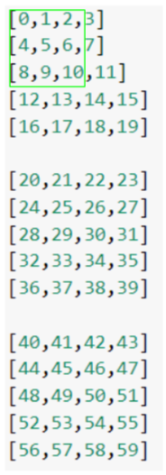
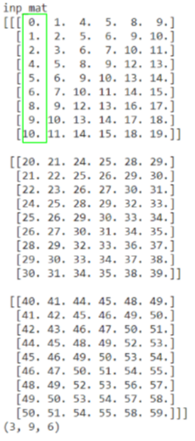
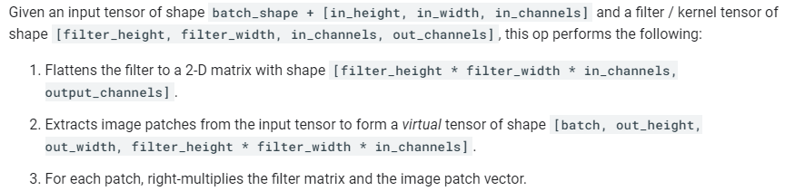
Conv2D Reconstruction
Figure 14 - TensorFlow Conv2D Implementation Documentation
Figure 15 - Image Example
Figure 16 - Vectorized Image Example
Notes:
To allow for complete project documentation, the methodology for reconstructing the vectorized Conv2D will be closely reviewed.
In the case of Conv2D function reconstruction we were given a high level algorithm which we must produce a low level implementation from. Shown in figure 14.
From this description, we have the knowledge that TensorFlow leverages the use of vectorization via the use of patch extraction to achieve their Conv2D implementation.
With the aid of our continually growing Google Cloud Model Suite, we created a Debug Suite that was essential in component testing for the custom CNN implementation.
Given a 3 channel image with dimensions 5x4, shown in figure 15. Highlighted in green is an example of a 3x3 kernel situated at the start of the input image.
Instead of applying convolution on the spatial domain, the vectorized approach would gather the input components in such a way that the convolution operation is equivalent to a matrix multiplication operation. Shown in figure 16 is the output of our custom implementation of the vectorization function.

Slide 25
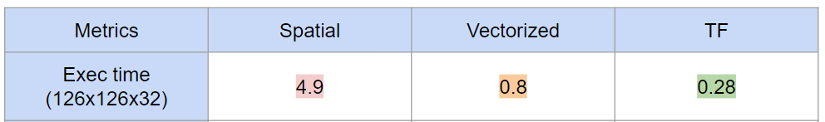
Conv2D Evaluation
Notes:
As can be deduced, the vectorized representation of the input image carries increased storage footprint, yet leverages increased performance.
Shown in following table, a comparison between the standard spatial convolution, our vectorized implementation and the TensorFlow implementation.
Our vectorized implementation leverages similar execution time over the same input compared to TensorFlow implementation.

Slide 26
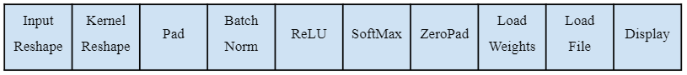
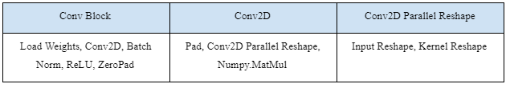
Custom CNN Low/High Level Functions
Table 1 - Low Level Functions
Table 2 - High Level Functions
Notes:
Shown are the low level and high level functions that implement each of the building blocks reviewed previously, by using the reconstruction methodology discussed.
These LL functions are included in the file named High Level Functions whereby the LL functions are used to implement higher level functionalities that more naturally implement the model architecture, shown in table 2 are the High Level Functions and the Low Level Functions that they utilize.
With this approach we were able to successfully reconstruct a fully custom MobileNet V1 forward pass implementation that does not rely on any TensorFlow libraries, an implementation that we can control and divide according to our requirements.

Slide 27
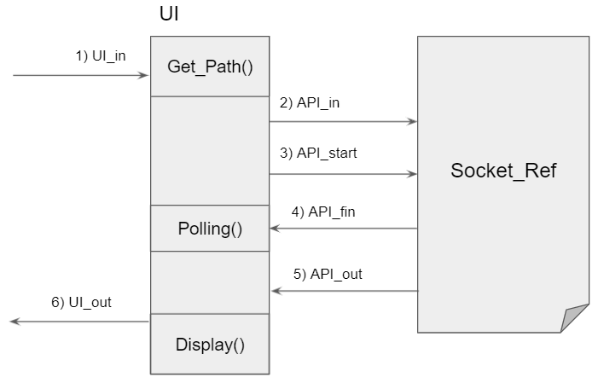
UI & Socket Interfacing
Figure 17 - UI & Socket interfacing
Notes:
In order to introduce the hardware acceleration component of the system, we carried out a full functional simulation of the whole system, whereby the hardware components are simulated via the use of software functions and emulated as real-time components via threading libraries.
Shown in figure 17 is the interfacing between the UI thread and the socket reference.
In practice, the socket reference is an array pointer that aims to emulate a socket communication between a simulation of a user interface and our emulated API which handles the model functionalities and interfaces with the FPGA thread.
The UI thread gets an image path as input and assigns its value to API_in. Then asserts API_start.
The UI thread is polling the API_fin value. When API_fin is asserted, the UI takes the value assigned to the API_out and passes it through the Display function which handles displaying the inferred value similar to the output shown in figure 12.

Slide 28
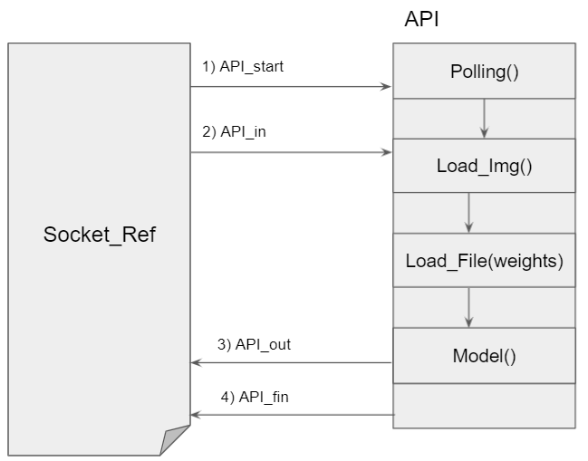
Socket & API Interfacing
Figure 18 - Socket & API interfacing
Notes:
Having polled an asserted API_start, the API takes in the value of API_in and uses it to load the input image into memory, followed by loading the model weights and calling the Model function. Upon the return of the Model function, the return value is assigned to API_out and API_fin is asserted.

Slide 29
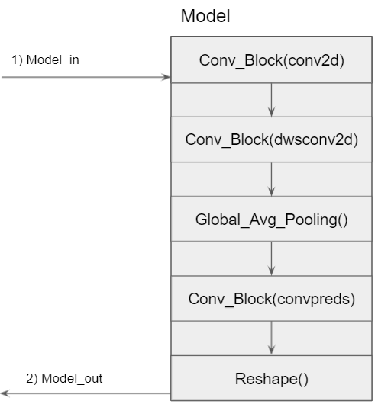
MobileNet V1 Model Component
Figure 19 - MobileNet V1 Model
Notes:
This function block exposes the high level functions called in order to achieve the MobileNet V1 architecture.
Having the input image introduced to a convolutional block of type Conv2D, followed by its output inserted into 13 consecutive convolutional blocks of type DWS Conv2D.
Following that, having its output introduced to a Global Average Pooling layer and finally a final convolutional block that begins the process of reshaping to meet the 12 class model output result.

Slide 30
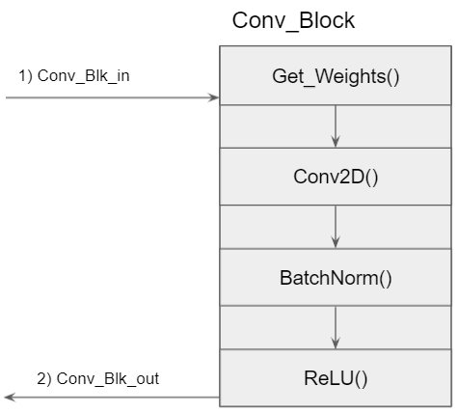
Conv Block Component
Figure 20 - Convolutional Block Function
Notes:
For every time the Conv Block function is called by the model, we get its respective weights from memory and apply the Conv2D function, followed by a batch normalization and a ReLU operation.
Thus achieving the exact convolutional block as disclosed in the MobileNet V1 white paper.

Slide 31
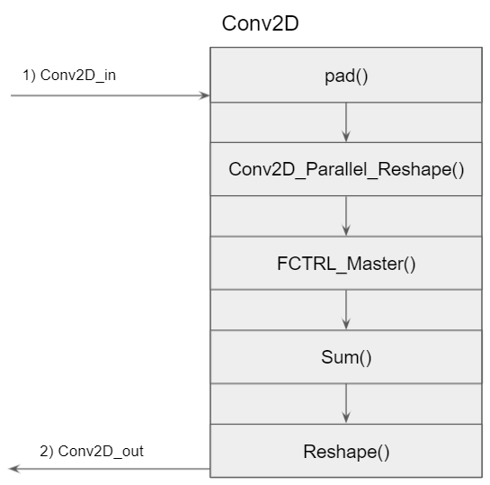
Unified Convolution Component
Figure 21 - Unified Convolutional Function
Notes:
An important approach that was applied in our Conv2D implementation is the fact that by leveraging the vectorization method we were able to unify both the standard Conv2D and the depthwise Conv2D by treating them both without discrimination as depthwise convolutions and accounting for distinctions at the end of the operation.
In both cases, a padding operation is executed for each convolutional block.
In the DW Conv2D operation, there exists two clauses: 1) Must have only one kernel. 2) The kernel’s depth must be equal to that of the input depth.
Thus, only convolutions over the depth occur, as reviewed previously.
However, in the case of the standard Conv2D, the first clause is not enforced and it supports a variable number of kernels.
Thus, through our debugging suite, we were able to overcome this challenge by reshaping the kernel in such a way so that the output matrix can be summed over and achieve a correct and parallel Conv2D functionality.

Slide 32
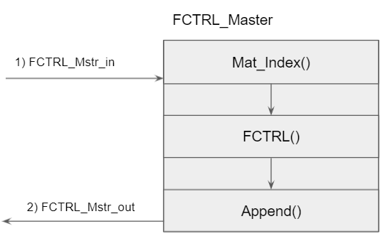
Flow Control Master Component
Figure 22 - Flow Control Master
Notes:
Moreover, the FCTRL master function receives the multidimensional, vectorized and reshaped input and kernel matrices.
In order to realistically approach the problem of flow control, our design only supports the matrix multiplication of two matrices, where each matrix is only two dimensional.
Thus, the two input matrices have their depth values indexed via the Matrix Index function.

Slide 33
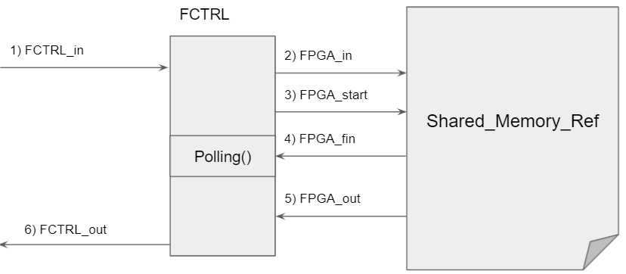
Flow Control & Shared Memory Interfacing
Figure 23 - Flow Control & Shared Memory Interfacing
Notes:
The FCTRL function takes the two dimensional matrices and writes and reads on the shared memory that is situated between the API and the FPGA, commanding the single purpose processor that is synthesized on the FPGA to start operation.
After the FPGA completes the matrix multiplication operation, the output value is returned to the flow control master whereby its appended.

Slide 34
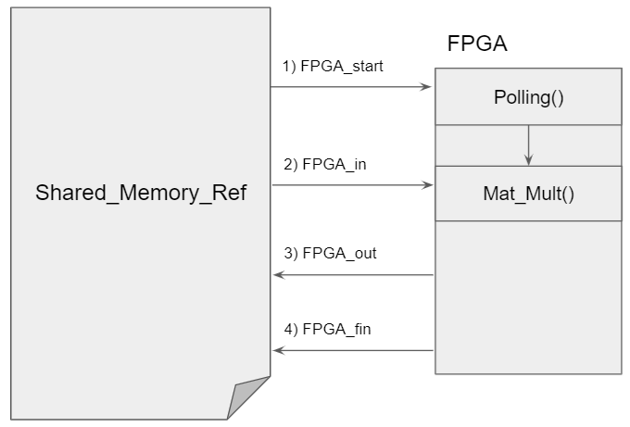
Shared Memory & FPGA Interfacing
Figure 24 - Shared Memory & FPGA Interfacing
Notes:
On the other side, as shown in figure 24, the FPGA is polling the FPGA_start and on assertion, takes the values in FPGA_in and begins its Matrix Multiplication routine.
On completion, the matrix multiplication output is assigned as well as the FPGA_fin asserted.
By following the thread of execution, one can understand the full functionality of our low level system design.

Slide 35
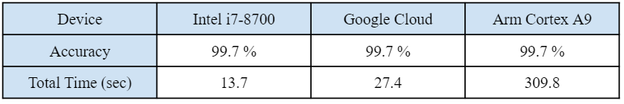
System Functional Simulation Metrics
Table 3 - Functional Simulation Metrics
Notes:
Following are the aggregate results of the functional simulation running on Intel(R) Core(TM) i7-8700, Google Cloud and the Arm Cortex A9 of the DE10 Standard FPGA.
The Intel and Google Cloud CPU architectures follow the x86 CPU architecture.
However, Arm Cortex employs its own reduced instruction architectures to enable low power consumption on embedded devices like the DE10 Standard board.
This explains the large difference in the time taken to run the same source code on the Arm Cortex device.

Slide 36
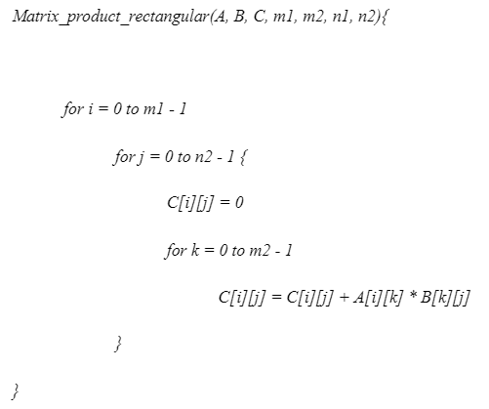
Custom Single Purpose Processor
Notes:
This algorithm multiplies A and B and stores the result in C. A and B have dimensions of m1 x m2 and n1 x n2, respectively.This algorithm enables the design of a digital circuit that applies rectangular matrix multiplication in RTL. The RTL design will be in FSMD (data path + FSM) architecture. The data path stores the data of the algorithm, applies the arithmetic operations and passes the conditions of the for loops to the controller (FSM). 66 On the other hand, FSM controls the flow of the data in the algorithms and writes the result in the output ram.

Slide 37
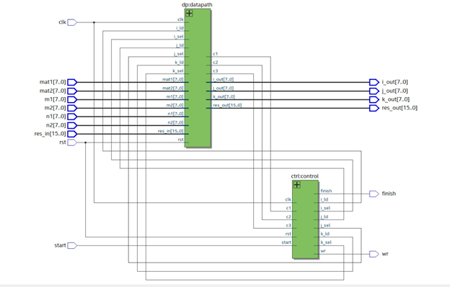
Top Level
Notes:
The architecture takes: - mat1: The output of the ram/rom that stores the first matrix needs to be multiplied. - Mat2: The output of the ram/rom that stores the second matrix needs to be multiplied. - m1: The number of rows in the first matrix. - m2: The number of columns in the first matrix. - n1: The number of rows in the second matrix. - n2: The number of columns in the first matrix. - res_in: The output of the result ram. - start: A signal to initiate the process of multiplying matrices. The output signals: - i_out, j_out, k_out : The addresses of the given matrices and the output matrix (I, j, k), as they are specified in the algorithm. - res_out: The value of an element in the output matrix. - wr: Signal to write res_out in the output ram. - finish: Signal to inform that the process has been terminated.

Slide 38
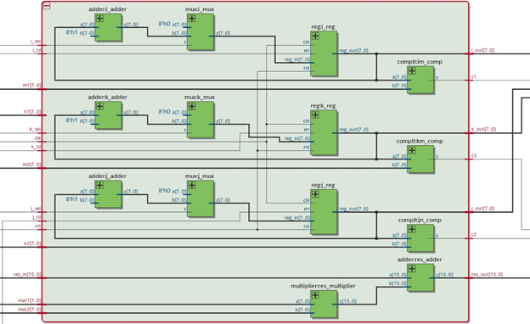
Datapath
Notes:
The data path architecture’ inputs are: - i_sel: Signal comes from the controller to control the selector signal of i_mux. - i_ld: Signal comes from the controller to control the enable signal of i_reg. - m1: The number of rows of the first matrix. - n1: The number of rows of the second matrix. - k_sel: Signal comes from the controller to control the selector signal of k_mux. - k_ld: Signal comes from the controller to control the enable signal of k_reg. - m2: The number of columns of the second matrix.
j_sel: Signal comes from the controller to control the selector signal of j_mux. - j_ld: Signal comes from the controller to control the enable signal of j_reg. - n2: The number of columns of the second matrix. - res_in: An element of the output matrix. - mat1: An element of the first matrix. - mat2: An element of the second matrix. The data path architecture’ outputs are: - i_out: The signal of address i. - c1: Signal of comparing i with m1. - k_out: The signal of address k. - c3: Signal of comparing k with m2. - j_out: The signal of address j. - c2: Signal of comparing j with n2. - res_out: The element to be stored in the output ram
The data path architecture’ components are: - i_adder: It is an adder to apply addition on the output signal of i_reg and one. - i_mux: It is a multiplexer to select the input of i_reg either it is the signal that comes from i_adder or zero. The selector of i_mux is i_sel. - i_reg: It is a register to store the signal that comes from i_mux. The enable signal of i_reg is i_ld. im_comp: It is a comparator that outputs one if the signal coming from i_reg is less than m1 and 0; otherwise. c1 is the signal that comes from im_comp. - k_adder: It is an adder to apply addition on the output signal of k_reg and one. - k_mux: It is a multiplexer to select the input of k_reg either it is the signal that comes from k_adder or zero. The selector of k_mux is k_sel. - k_reg: It is a register to store the signal that comes from k_mux. The enable signal of k_reg is k_ld. - km_comp: It is a comparator that outputs one if the signal coming from k_reg is less than m2 and 0; otherwise. c3 is the signal that comes from km_comp. - j_adder: It is an adder to apply addition on the output signal of j_reg and one. - j_mux: It is a multiplexer to select the input of j_reg either it is the signal that comes from j_adder or zero. The selector of j_mux is j_sel. - j_reg: It is a register to store the signal that comes from j_mux. The enable signal of j_reg is j_ld. - jn_comp: It is a comparator that outputs one if the signal coming from j_reg is less than n2 and 0; otherwise. c2 is the signal that comes from jn_comp. - res_multiplier: It is a multiplier to apply multiplication on the mat1 and mat2 signals. - res_adder: It is an adder to apply addition on the output signal of res_multiplier and res_in.

Slide 39
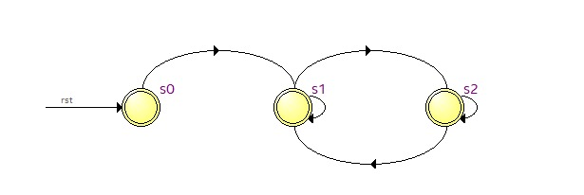
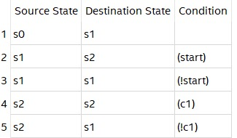
FSM Controller
Notes:
As it is shown in this figure [2], the FSM contains three states. The first state s0, generally, spares one clock period of time and transits to s1 unconditionally. State s1 initializes the data with their initial values to be prepared before initiating the loops in s2. State s2 implements the for loops in the algorithm given the conditions signals from the data path. This table shows the transitions from one state to another. State s0 transits to s1 without any conditions. State s1 would transit to s1 if the signal starts enabled; otherwise, it remains in state s1. State s2 remains in s2 as long as I is less than m1 (signal c1 that comes from the data path); otherwise, the algorithm terminates and returns back to state s1, waiting for another start signal to start the process again. The controller architecture’ outputs are: - i_sel - i_ld - k_sel- k_ld - j_sel - j_ld - wr The controller architecture’ inputs are: - c1. - c3. - c2. - start: Signal to begin the process of the algorithm.
The outputs of the controller differ given the conditions signals that come from the data path (c1, c2, c3). In state s0: i_sel = 0. i_ld = 0. k_sel = 0 k_ld = 0. j_sel = 0. j_ld = 0. wr = 0. finish = 0. In state s0, nothing happens but transition to state s1. In state s1: i_sel = 0. i_ld = 1. k_sel = 0. k_ld = 1. j_sel = 0. j_ld = 1. wr = 0. finish = 0 In-state s1, the registers i_reg, j_reg, k_reg are stored by a value equal to zero. i_sel, j_sel, and k_sel make their multiplexers output zero when they are equal to zero.

Slide 40
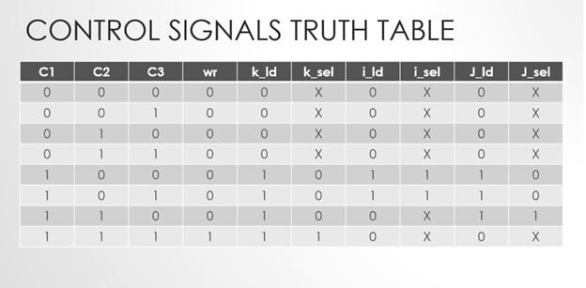
S2 Truth Table
Notes:
As it is shown in the table: - When c1 (i < m1) is not enabled, the algorithm terminates, and the FSM transits to s1. k_ld, i_ld, j_ld, and wr signals are not enabled. Finish signal will be enabled. - When c1 ( i < m1) is enabled and c2 (j < n2) is disabled, the algorithm is still in the first loop but the second loop terminates. Therefore, i = i + 1 (i_ld = 1, i_sel = 1), j = 0 (j_ld = 1, j_sel = 0), k =0 (k_ld = 1, k_sel = 0) and wr signal is disabled. - When c1 ( i < m1) is enabled, c2 (j < n2) is enabled and c3 (k < m2) is disabled, the algorithm is still in the first two loops but the third loop terminates. Therefore, j = j + 1 (j_ld = 1, j_sel = 1), k =0 (k_ld = 1, k_sel = 0) and wr and i_ld signals are disabled. - When c1 ( i < m1) is enabled, c2 (j < n2) is enabled and c3 (k < m2) is enabled, the algorithm is in the third loop. Therefore, k = k + 1 (k_ld = 1, k_sel = 1), wr = 1 and i_ld and j_ld signals are disabled.

Slide 41
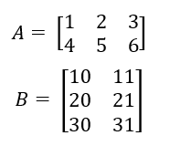
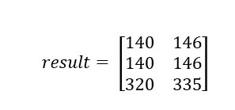
Experimental Result
Notes:
Testing for a simple example, given a matrix A 2 x 3 and B 3 x 2 to be like that. A matrix is stored in a ROM 3 x 4, which matrix A takes only the first two rows and first three columns. B matrix is stored in a ROM 4 x 3, which matrix B takes only the first three rows and first two columns.

Slide 42
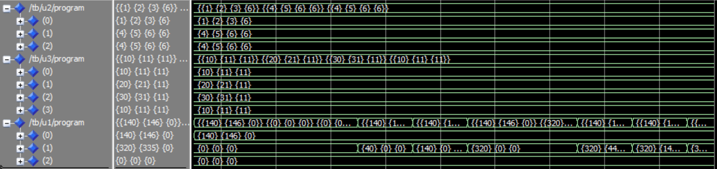
Function Simulation
Notes:
The extra rows and columns in the two input ROMs are stored with arbitrary values. The three rows and two columns in the result matrix give the output matrix of multiplying the A matrix and B matrix.

Slide 43
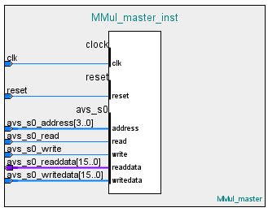
Custom Peripheral
Figure 25 - Peripheral Block Diagram
Notes:
The only remaining step is wrapping the SPP around an interface level abstraction, to allow for the HPS & FPGA transreceving.
With the knowledge of peripheral terminology; we want to create a memory mapped slave peripheral, whereby it has two masters; the HPS and the FPGA. Following is the block diagram for the custom peripheral.
The peripheral is set up in such a way that the avs_s0 IOs are controlled directly by the peripheral masters.

Slide 44
Peripheral Registers
Figure 26 - Peripheral Registers
Loading Kernel Matrix (0x11)
Loading Input Matrix (0x21)
Matrix Multiplication Start (0x06)
Matrix Multiplication Finish (0x08)
Unloading Output Matrix (0x48)
Completion/Reset (0x0A)
Notes:
Our design follows a 16 bit data word register width to allow for reduced processing footprint and lower bus width. Following are the peripheral registers.
The functionalities of the I, J, K and N registers change depending on the value of the S register. Exploring the different values that the S register holds will shine a light in understanding the functionality of the peripheral.

Slide 45
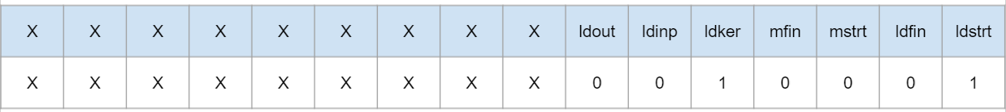
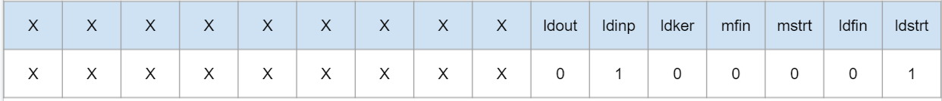
Loading Kernel & Input
Figure 27 - Peripheral S Register During Kernel Loading
Figure 28 - Peripheral S Register During Input Loading
Notes:
Having the S register assigned the value of 0x11 would mean that the system is in the kernel loading state such that the I and J registers will hold the Row and Column index values respectively. While having the N register hold the numeric value.
Similarly, in the input loading state with S register assigned 0x21, the I register is used for Row indexing and the K register is used for column indexing, with the N register also holding the numeric value at the same index.
In practice, the python code situated at the HPS loops at each value until both the kernel and input matrices are loaded into the shared memory.

Slide 46


Multiplication Start & Finish
Figure 29 - Peripheral S Register During Matrix Multiplication
Figure 30 - Peripheral S Register After Matrix Multiplication
Notes:
After loading, the HPS assigns the I, J and K registers the values that correspond to the number of rows in the kernel matrix, number of columns in the input matrix and the number of columns in the kernel matrix respectively.
These values are used in the SPP in order to execute its functional algorithm as discussed earlier.
Assigning the S register a value of 0x06 will start the matrix multiplication process on the FPGA. The HPS would poll the S register for a value of 0x08 which is the value that the FPGA would assign to the S register upon its completion.

Slide 47


Unloading & Reset
Figure 31 - Peripheral S Register During Output Unload
Figure 32 - Peripheral S Register After Completion/Reset
Notes:
Finally, the HPS would assign the S register to the value of 0x48 and begin unloading the output matrix values via the use of I and K for Row and Column indexing.
A challenge is met when discussing multiplication fundamentals, when multiplying two 16 bit numbers the output can be in range of a 32 bit number.
Thus, we overcome this challenge by having the internal output register designed as a 32 bit register and when unloading the output the least significant 16 bits would be read from the N register and the most significant 16 bits would be read from the K register.
Then finally, When a value of 0x0A is assigned to the S register of the peripheral, the peripheral resets its internal registers as well as issues a reset signal to the SPP component.

Slide 48


System Implementation
Table 4 - Largest Matrix Sizes (Two Dimensional)
Notes:
Combining all the components mentioned previously into one implementation would allow for a full system implementation. However, this stage is where the system limitations and the challenge of constraints are most prevalent, where precaution and research are rewarded.
The main challenge was one of utilization constraints, the DE10 Standard contains 41.910 Kb of logical elements bandwidth. Shown below is our smallest footprint model, with its largest matrix sizes required displayed.
Even though MobileNet V1 provides a high reduction in parameter size, this is still not sufficient in order to simply load all the values and execute.
Thus, in order to attempt a realistic implementation, the flow of data between the HPS and the FPGA must be throttled.

Slide 49


Register Based
Table 5 - Largest Matrix Sizes (One Dimensional)
Figure 33 - Register Based System Summary
Notes:
Following is the system implementation where the shared memory is deployed in the form of register components.
in table 9, we designed the registers in such a way that the matrix multiplication is carried in a one dimensional manner. This achieves the required system functionality successfully while utilizing a minimal utilization footprint.
However, this approach incurs massive overhead in terms of IO utilization and repeated and inefficient loadings of input values due to the nature of matrix multiplication.
Shown in figure 33, is the Quartus Utilization Summary for the register based system.
The under utilization of the DE10 board can provide an approach for lower end devices, however in order to fully utilize its performance advancement an iteration on the base design is undertaken, whereby the SPP component relies on block ram memory instead of register based memory.

Slide 50


BRAM Based
Table 6 - Largest Matrix Sizes (Reduced)
Figure 34 - Block Ram Based System Summary
Notes:
The DE10 BRAM embedded memory bandwidth is much larger than its logical element limit, having approximately 5,662 Kb available. Shown in figure 34 is the Quartus Utilization Summary for the BRAM based system.
The BRAM iteration sports a significant decrease in execution time compared to the register based design. However, referencing table 8, it would however be unable to house the output matrix due to its sheer relative size. In order to overcome this challenge and with the aid of the dynamic nature of our design, we designed this BRAM iteration to have the HPS process the first four convolutional blocks of our custom CNN MobileNet V1 architecture, and offload the reset of the convolutional blocks to the FPGA. This reduction provided the following largest matrix sizes metrics shown in table 6.

Slide 51

Evaluation
Table 7 - System Implementation Metrics
Notes:
Shown in table 11 is the comparison of the register based, BRAM and the functional simulation implementation which will provide needed contrast on the whole project implementation.
The register based implementation is a valid approach, it is however constrained by the inefficient method of memory loading. The BRAM approach more closely resembles the functional simulation in its total time in execution. In the case of the functional simulation, the matrices are already loaded into memory and are processed on command. However, a 23.7 incurred overhead is added to the BRAM approach due to memory loading and unloading from the HPS to FPGA components.

Slide 52

Applicational Implementation Technical Demo
Notes:
We prepared a technical demo for the applicational implementation.

Slide 53

MNIST VHDL Implementation

Slide 54

Introduction

Slide 55

Input Layer
Receive the input image and kernel values of the CNN
Store this values to memories ROMS
Create the input of the Convolution Layer

Slide 56



Convolution Layer

Slide 57

Functional Simulation of the Convolution Layer

Slide 58

Pooling Layer

Slide 59

Finite State Machine of the Demux FSM

Slide 60

Finite State Machine of the Max Pooling FSM

Slide 61

Functional Simulation of the Pooling Layer

Slide 62


Fully Connected Layer

Slide 63

Overall Design Architecture

Slide 64

Functional Simulation of the Overall Design

Slide 65

Timing Simulation of the Overall Design

Slide 66


Quartus Resources and Outputs for Overall Design

Slide 67
Design Codes
Applicational Implementation
MNIST VHDL Implementation

Slide 68
Thank you

Slide 69
References
Kyriakos, A. (2019). High Performance Accelerator for CNN Applications. 29th International Symposium on Power and Timing Modeling, Optimization and Simulation (PATMOS 2019) (pp. 135-140). Athens: c 2019 IEEE .
D. Steinkraus, I. Buck, and P. Y. Simard, “Using GPUs for machine learning algorithms,” in Eighth International Conference on Document Analysis and Recognition (ICDAR 05), 2005.
K. Ovtcharov, O. Ruwase, J. Kim, J. Fowers, K. Strauss, and E. S. Chung, “Accelerating Deep Convolutional Neural Networks Using Specialized Hardware,” Microsoft Res. Whitepaper, 2015. 56
Xilinx XST user guide. (2009). Xilinx, Inc.
D. Steinkraus, I. Buck, and P. Y. Simard, “Using GPUs for machine learning algorithms,” in Eighth International Conference on Document Analysis and Recognition (ICDAR 05), 2005
K. Ovtcharov, O. Ruwase, J. Kim, J. Fowers, K. Strauss, and E. S. Chung, “Accelerating Deep Convolutional Neural Networks Using Specialized Hardware,” Microsoft Res.Whitepaper, 2015.

